Slide 1



INTERNSHIP REPORT
SWE 420
Sourav Ahmed
2018831068
Department of Software Engineering
Institute of Information and Communication Technology - IICT, SUST
August 7, 2023
Performed At
ShellBeeHaken Ltd.
Level 6 & 7, House 1077, Road 6A, Avenue 8, Mirpur DOHS, Dhaka 1216

Slide 2
COMPANY PROFILE

Slide 3

"Support Your Business With Technology."
ShellBeeHaken Ltd. is a product-based software development company that specializes in customized software solutions for various domains and platforms. The company was established in 2020 and has a team of 30+ members who work on web development, mobile application development, technology consulting, enterprise solutions, custom software, and ecommerce.

Slide 4
Services
Web Development
Mobile Application Development
Technology Consulting
Enterprise Solutions
Custom Software
E-commerce
Cloud Services
DevOps Services
SQA
Database Management
Highly Scalable System Design

Slide 5

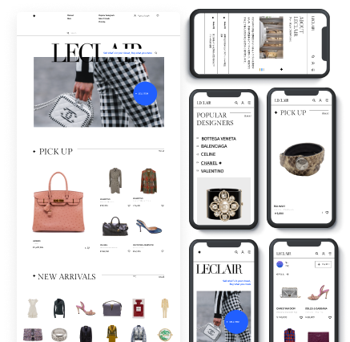
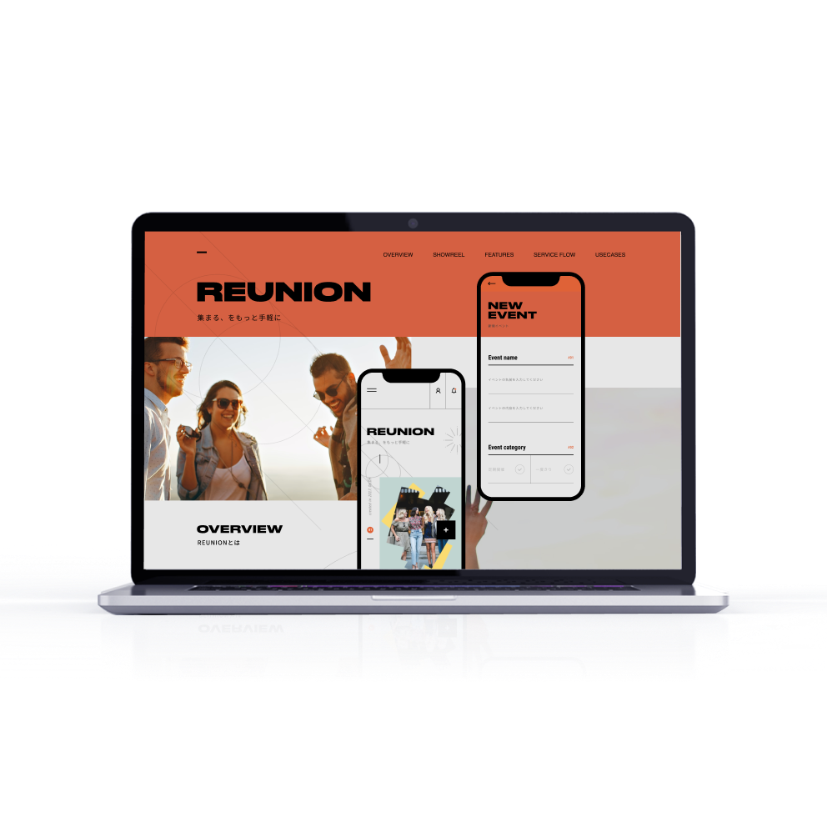
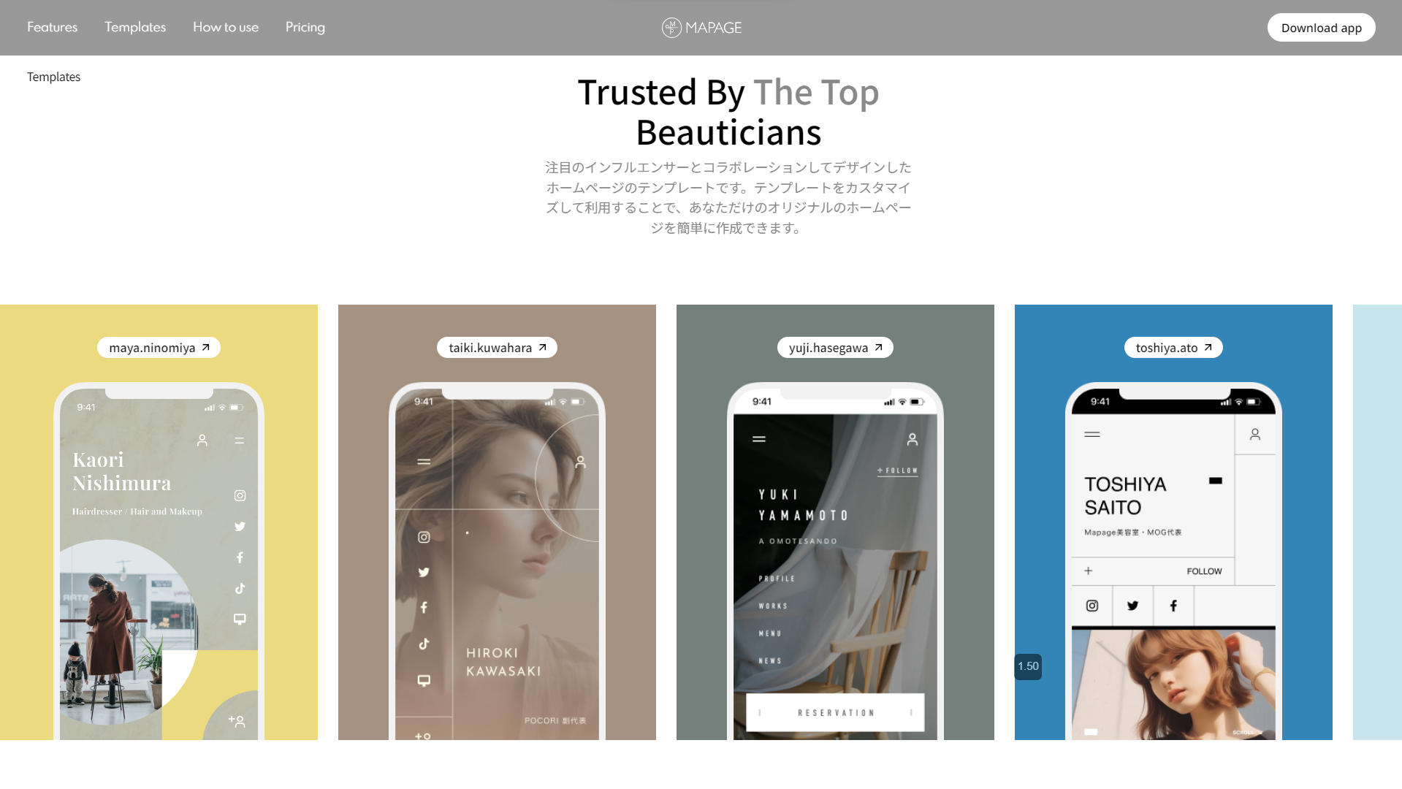
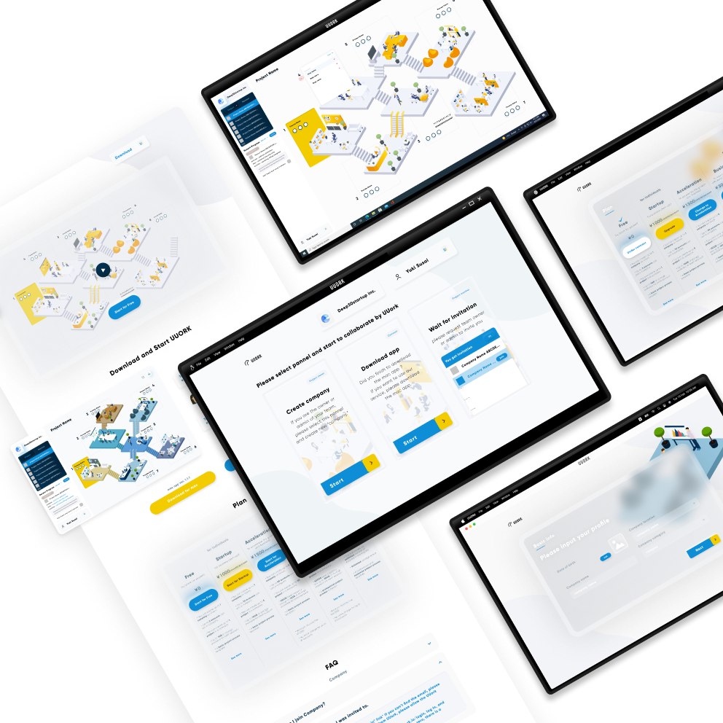
Project
Toyota Website: ShellBeeHaken redesigned Toyota’s website to make it responsive, user-friendly, informative, and SEO-optimized.
UUORK: ShellBeeHaken developed UUORK, a virtual company management platform that enables remote project teams and workflows.
Leclair: ShellBeeHaken created Leclair, an online luxury consignment store that sells authentic designer items on behalf of customers.
Reunion: ShellBeeHaken built Reunion, an app that connects users with their alumni community and hosts virtual events.
Foommy: ShellBeeHaken helped develop a proof of concept for Foommy, a service that introduces customers to restaurants using video snippets.
Mapage: ShellBeeHaken designed Mapage, a versatile branding tool for freelance beauticians and hairdressers.

Slide 6
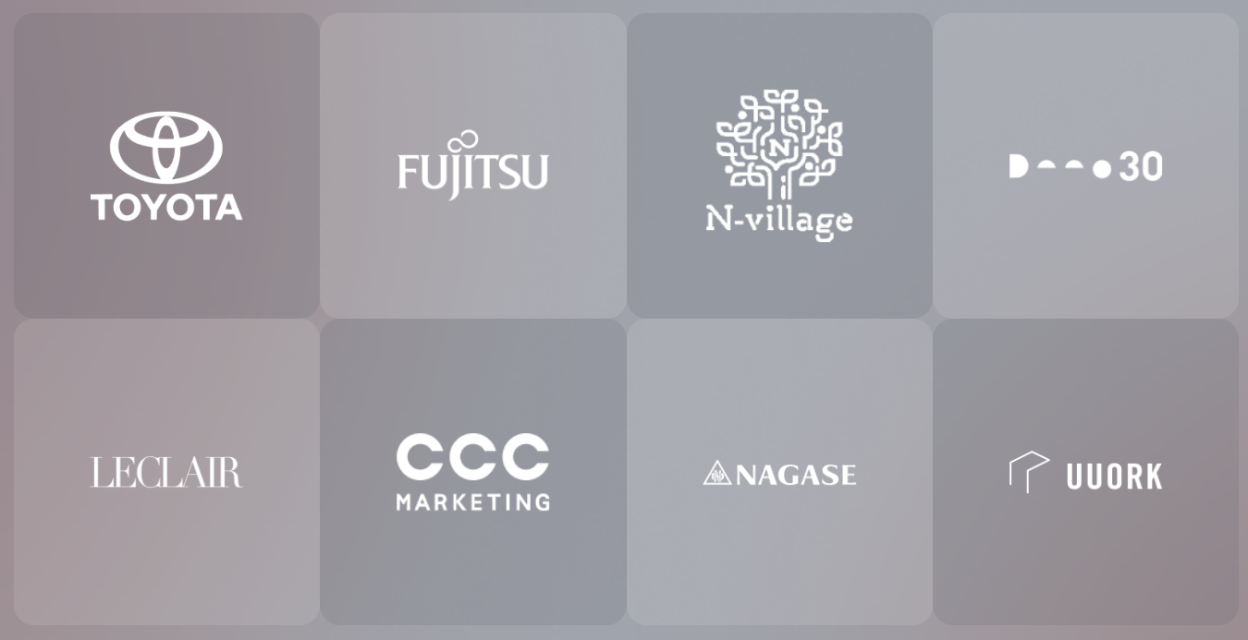
Customer & Partners
ShellBeeHaken Ltd has worked with global brands such as Toyota, Fujitsu, Nagase, UUORK, Leclair to create user-friendly, innovative, and scalable products.

Slide 7
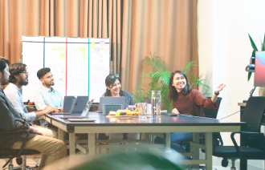

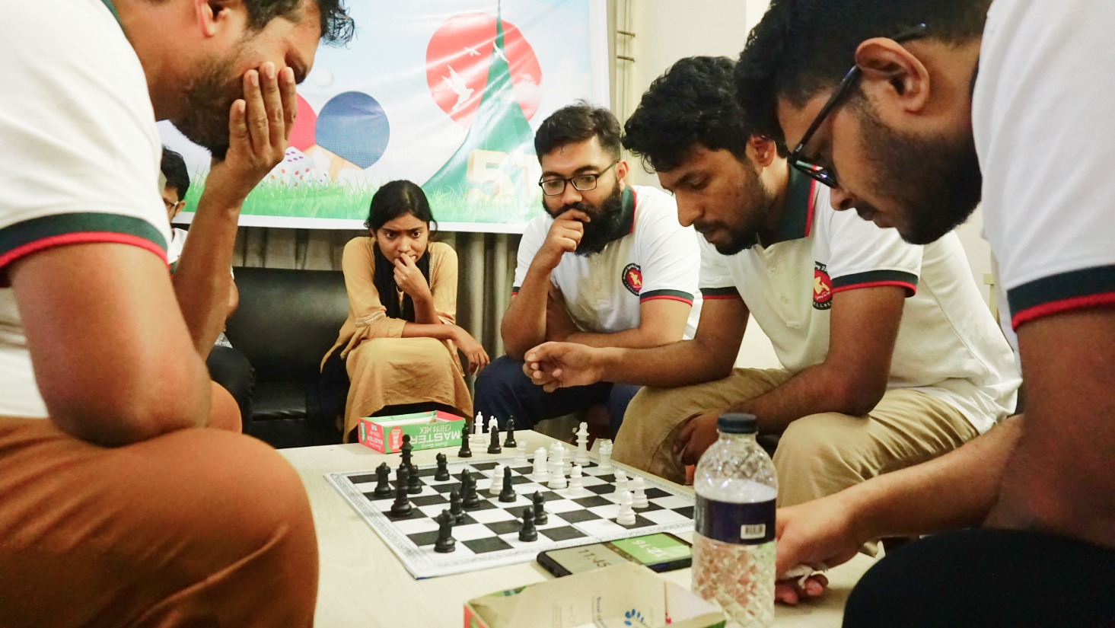
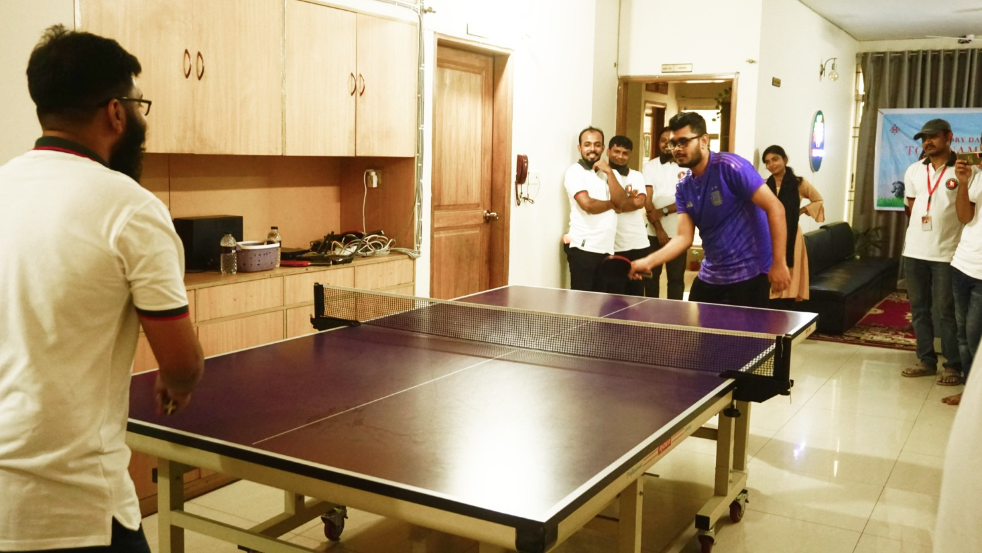
Facilities for employees
Nurturing Environment
Breakfast Lunch and snacks
Yearly increment
Festive Bonus
Paid leave
Metro rail travel expenses
Indoor and outdoor games
Recreation

Slide 8
Daily Routine of An SBH Employee
The employee can arrive at the office from 8:15 am and enjoys a nutritious breakfast provided by the company.
The employee attends the stand-up meeting with the team at 9:05 am to describe and coordinate the work plan for the day.
The employee works on the assigned tasks until the team meeting, which takes place between 11:00 am - 1:00 pm or 2:00 pm - 4:00 pm, depending on the project.The employee shares the work done, gets feedback, and learns new skills and methods from the team leader and other experts during the team meeting.
The employee joins the sprint meeting every Tuesday to review and set goals and achievements for the previous and next 2 weeks with the team.
The employee takes a lunch break from 1:00 pm to 2:00 pm (or 2:30 pm on Friday) and relishes a tasty meal provided by the company, with special items every Wednesday.
The employee can take breaks anytime for prayer, snacks, and beverages, which are available in the office pantry.
The employee resumes work after lunch until 6:00 pm, when the stand-down meeting occurs. The employee describes and celebrates the work done that day with the team during the stand-down meeting.

Slide 9
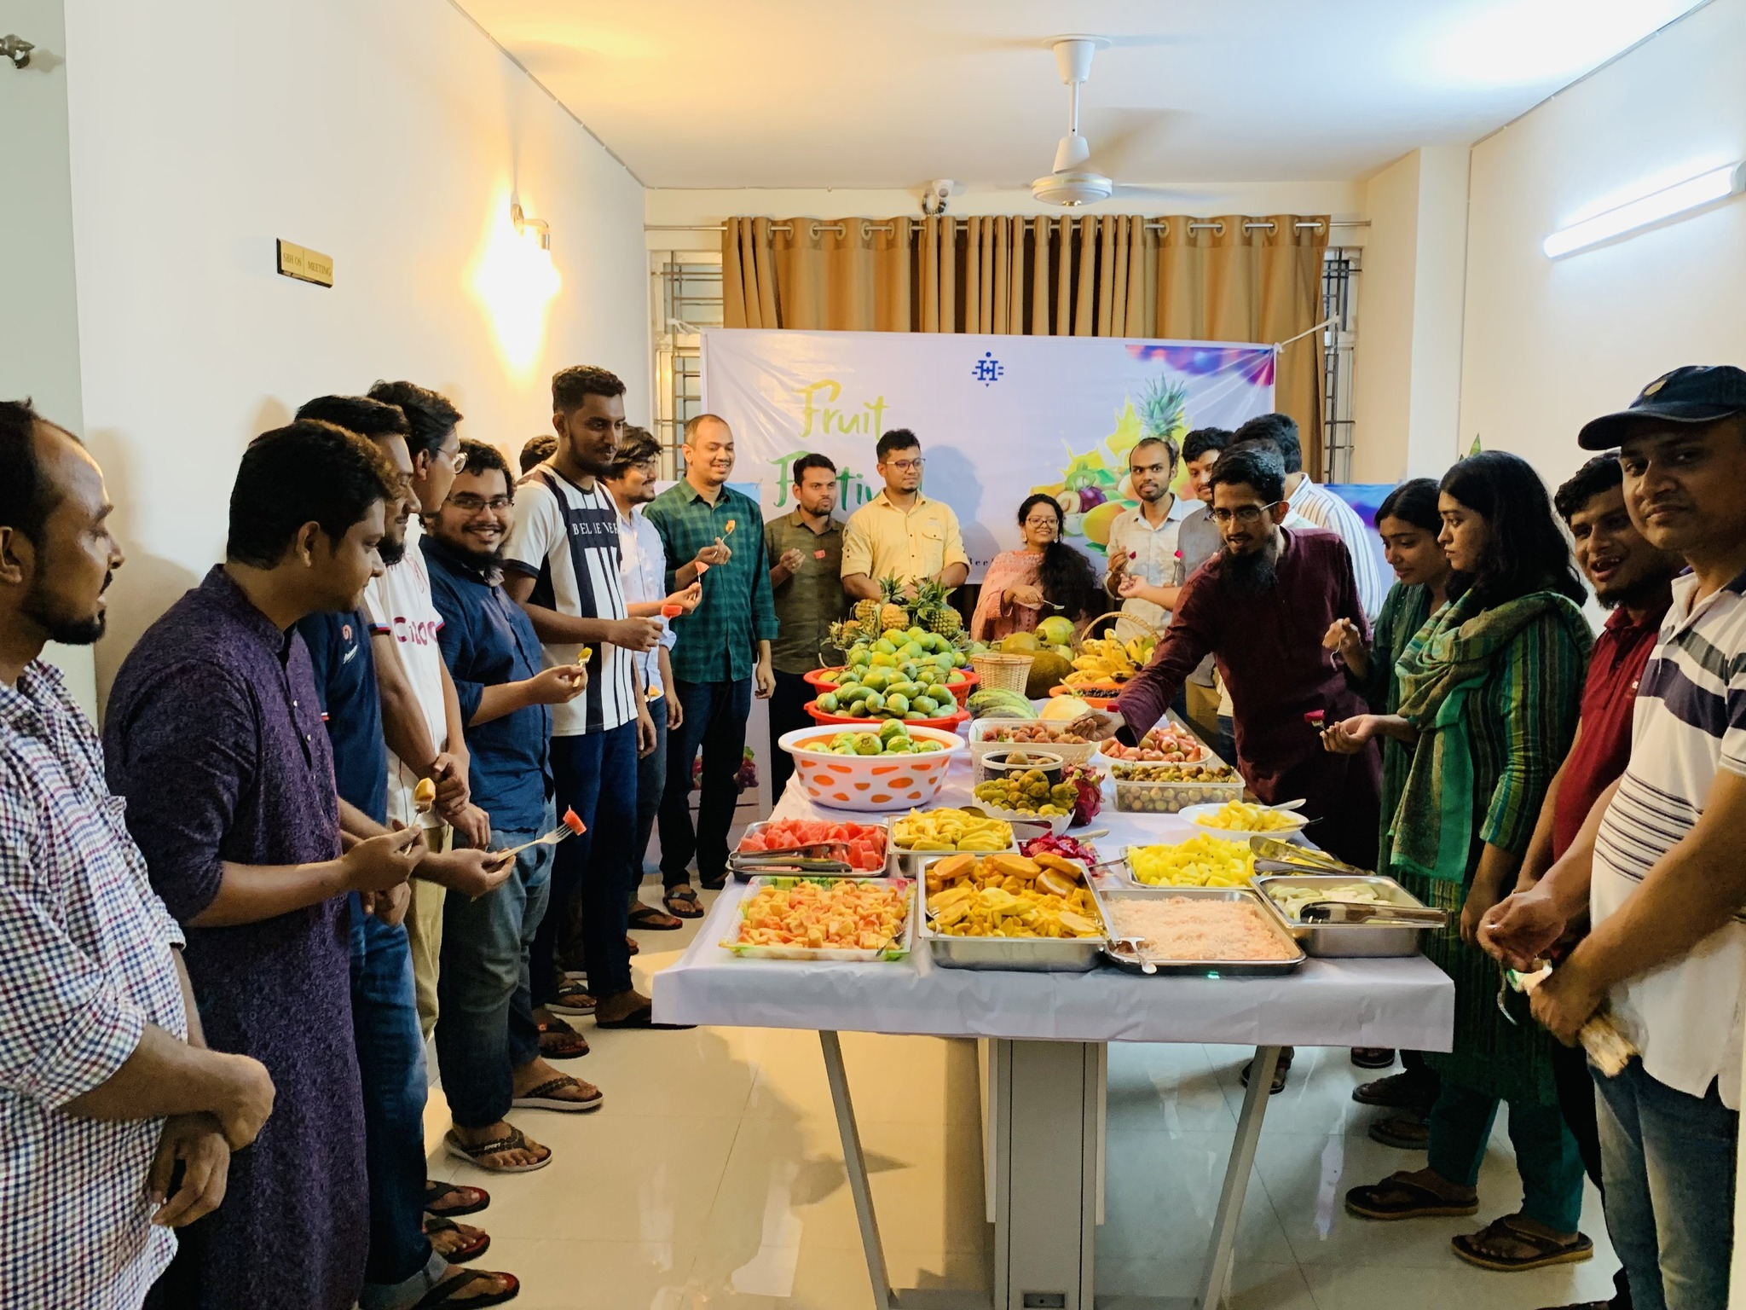
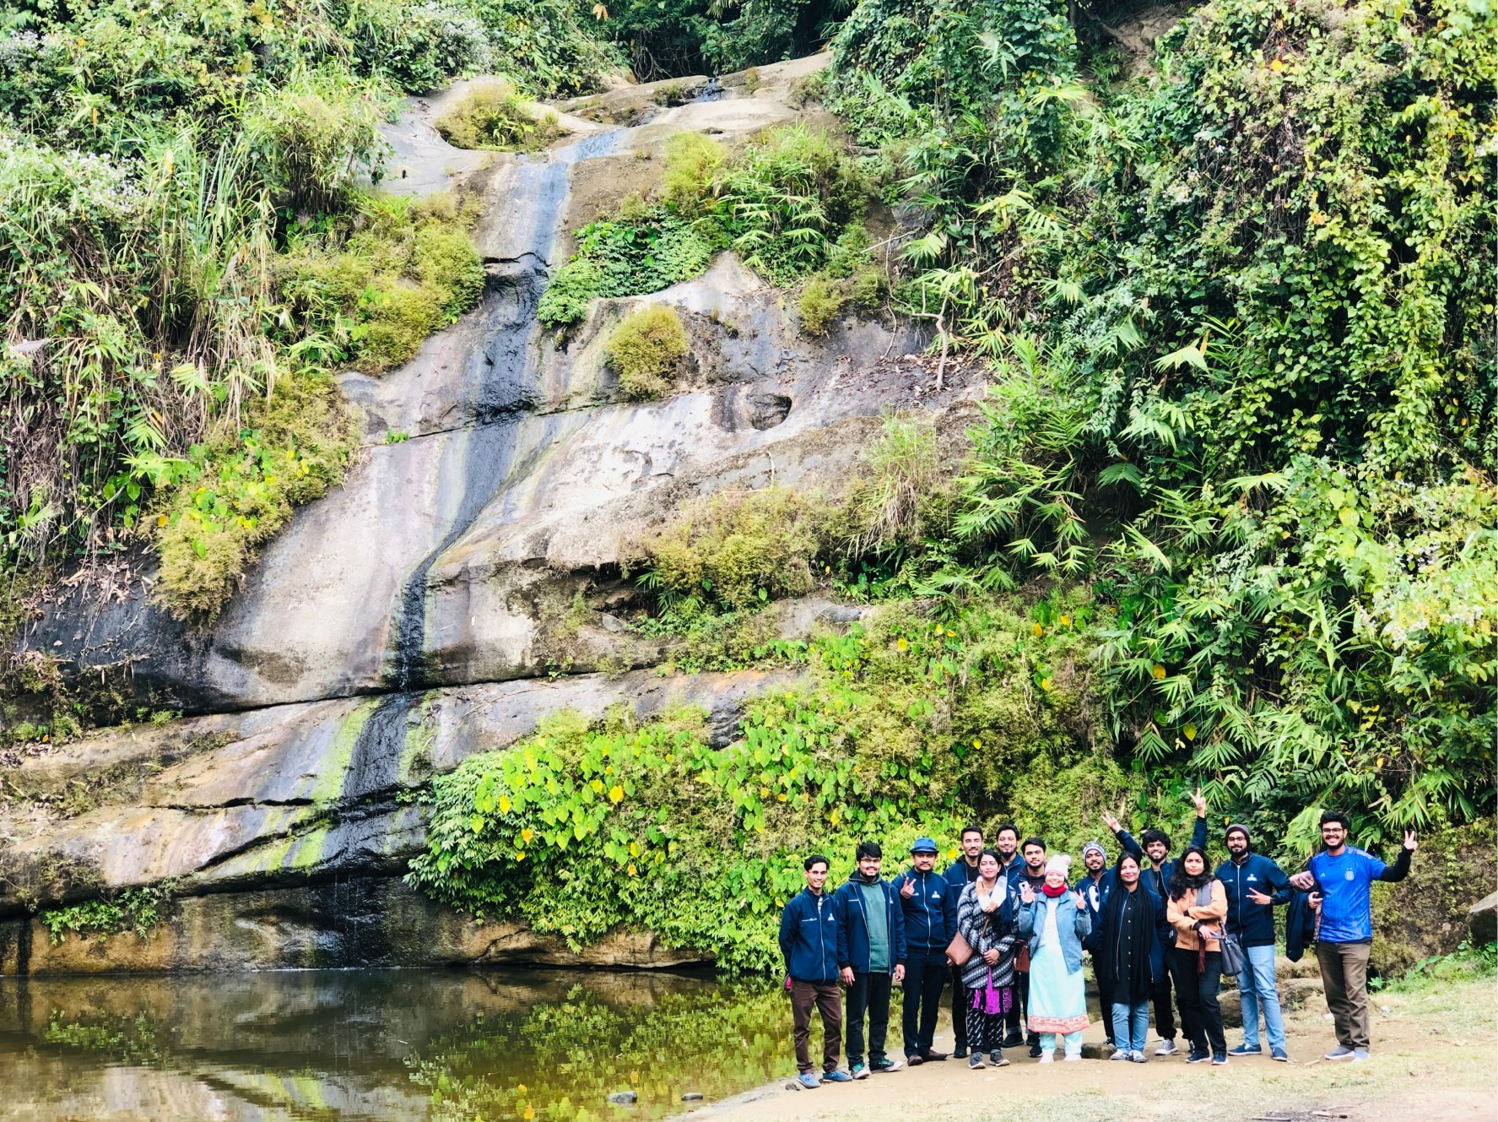
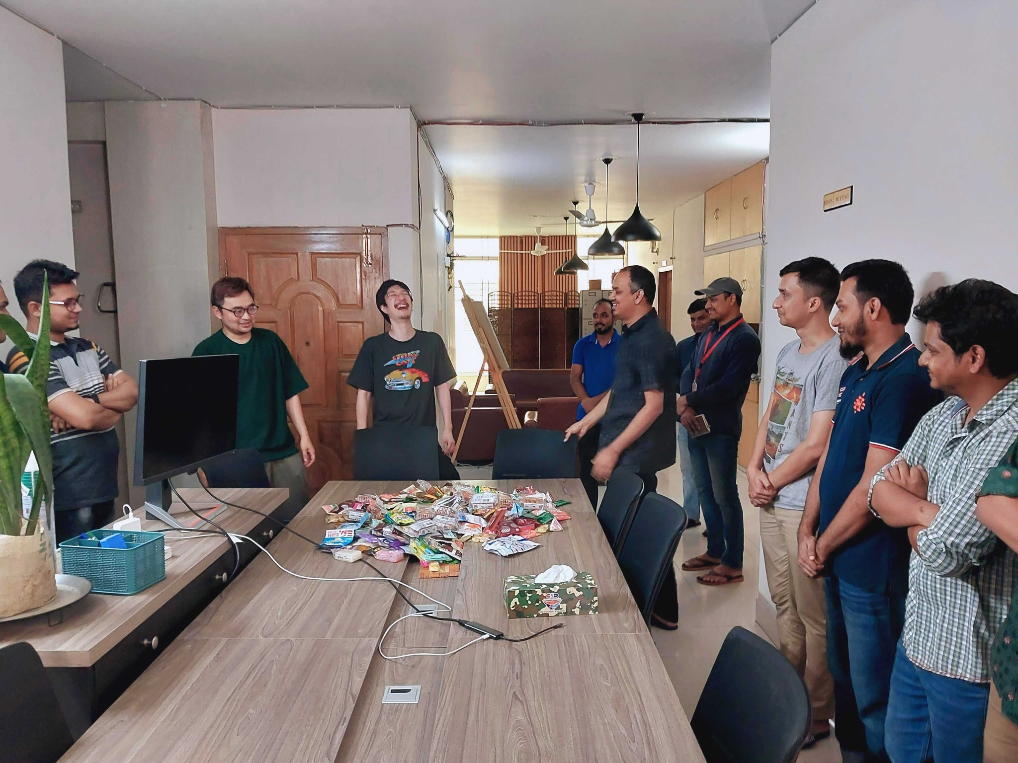
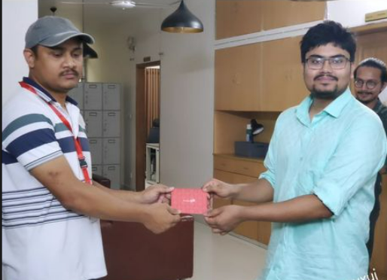
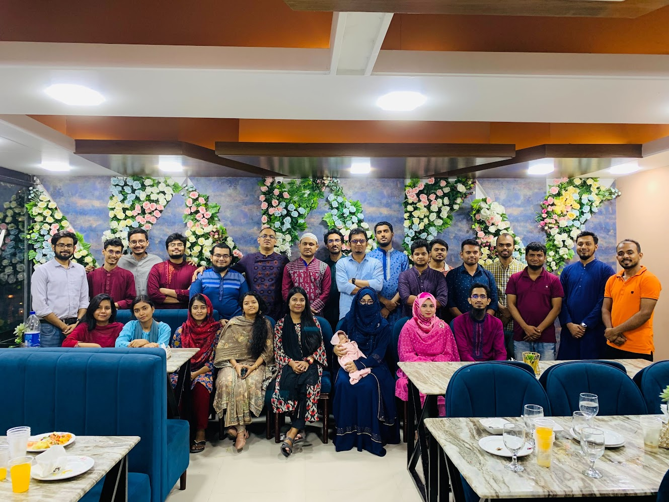
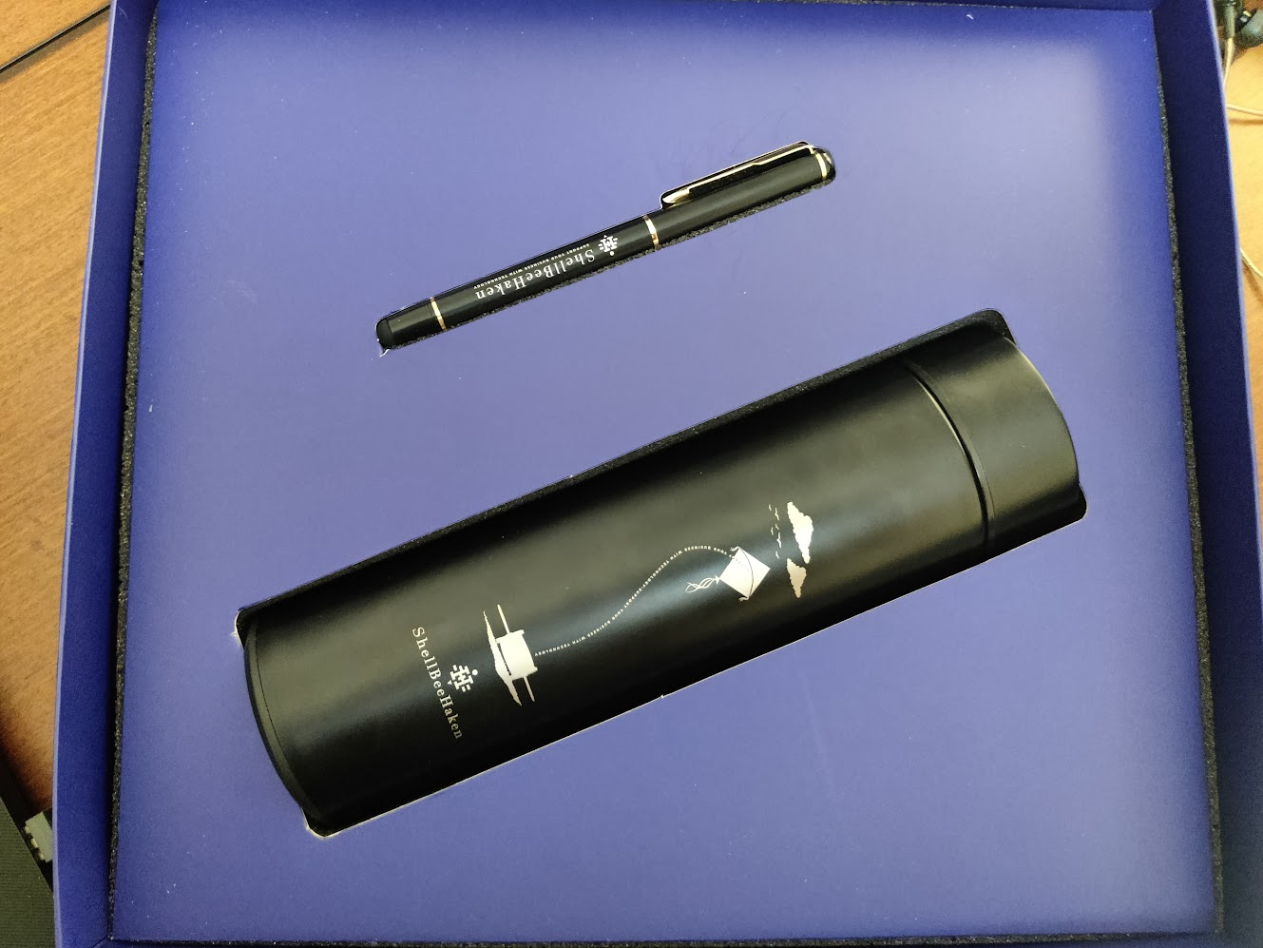
Activities
Business Tour 2022 at Bandarban
Annual Iftar & Dinner Party April 2023
Fruit Festival June 2023
Gifts for Employees

Slide 10
INTERNSHIP ACTIVITIES

Slide 11
Activities
Six month of internship was roughly divided into 4 phase.
Phase 1: Learning the Basics and Frameworks.
Phase 2: Learning Software Development methodologies, Software Architecture and High-Level Design.
Phase 3: Full Stack Project.
Phase 4: Working on the Company’s Live Projects.

Slide 12
Phase 1: Learning The Basics and Frameworks
I learned web development skills at ShellBeeHaken Ltd., starting from HTML, CSS, JavaScript, and Git, and then moving to React, Redux, ExpressJs, ElectronJs, MongoDB, Mongoose, and JWT. I had to study, take tests, and do assignments using these technologies.
Steps:
Study the topic
Make a working project
Evaluation test

Slide 13
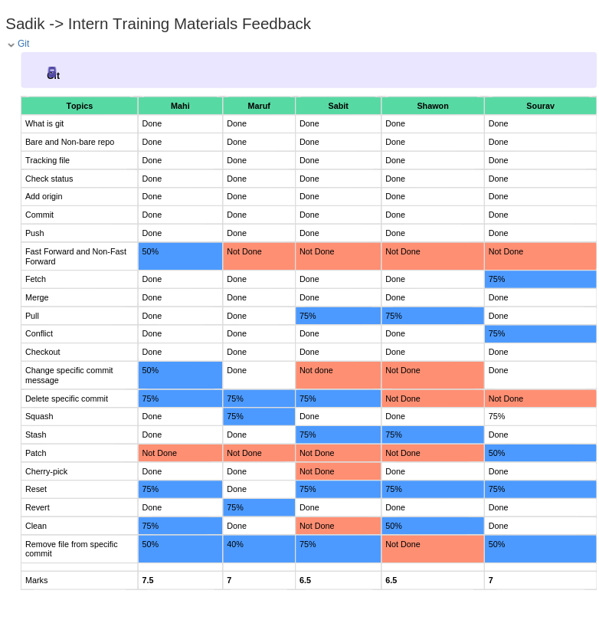
One of the marksheet

Slide 14
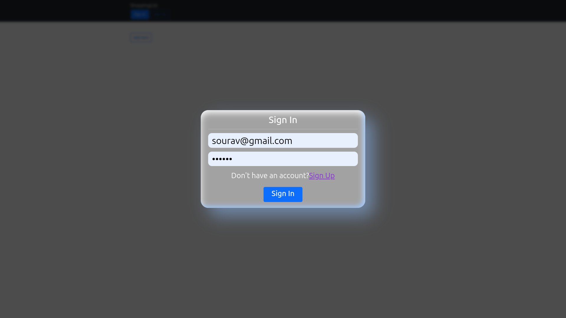
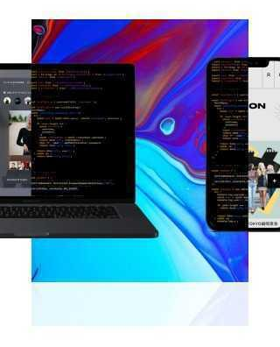
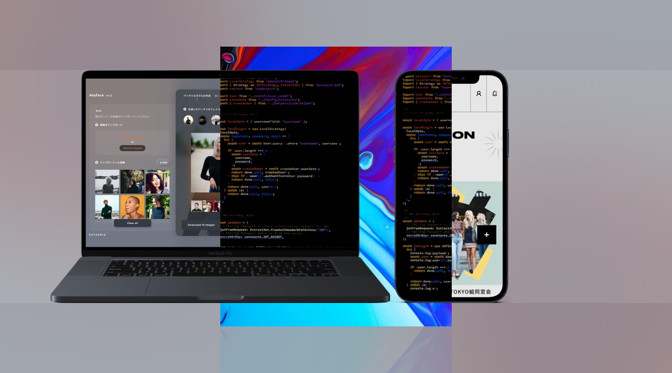
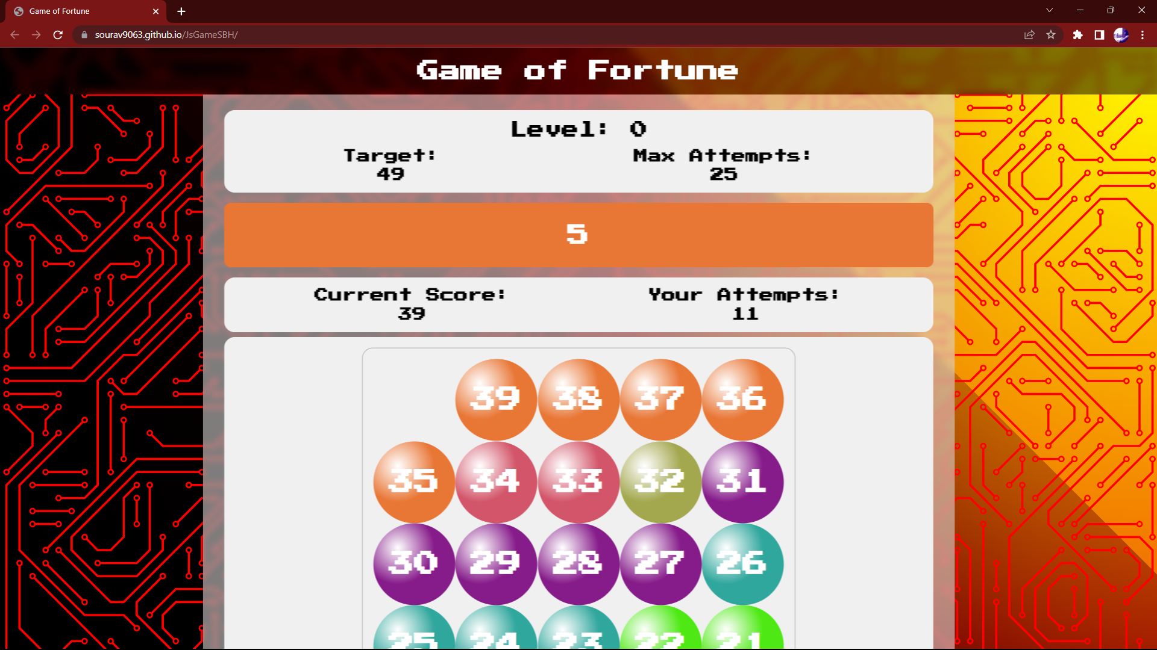
Some of The Projects of Phase 1
Replicating a responsive design using HTML and CSS
Answering 10 interview questions using JavaScript
Making a game using HTML, CSS, and JavaScript
For React I had to recreate the game that I made in the first phase
I had to create a simple shopping list web application Using React, Redux, MongoDB, ExpressJs, JWT token.

Slide 15
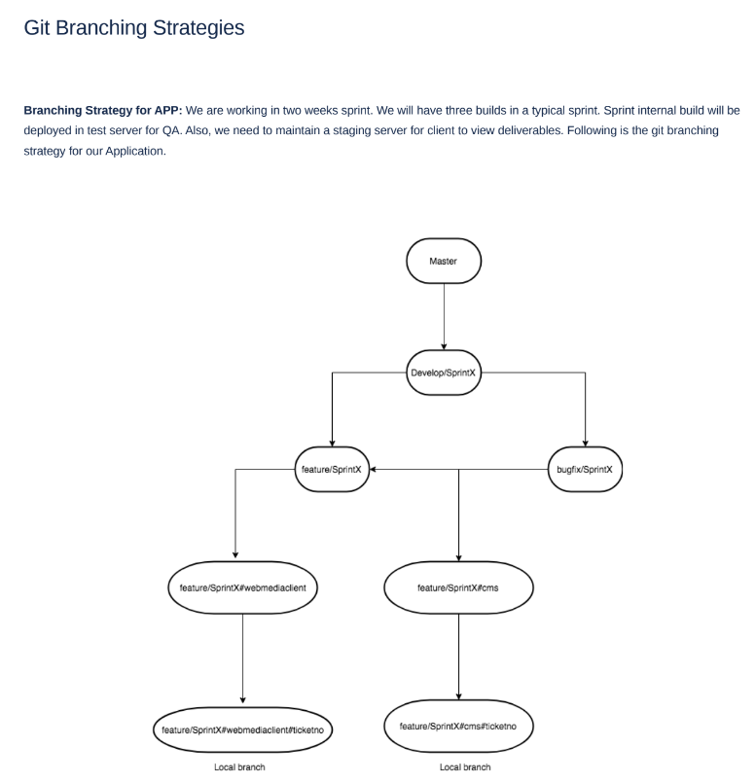
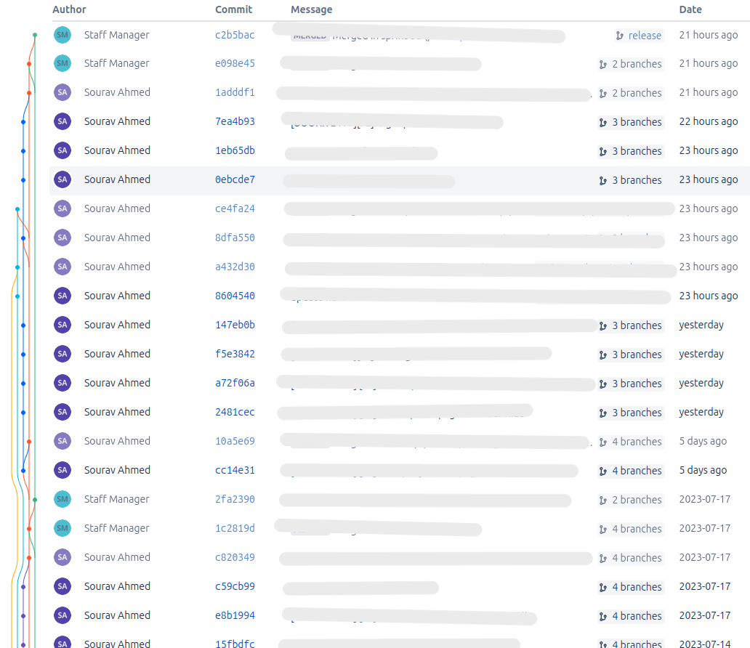
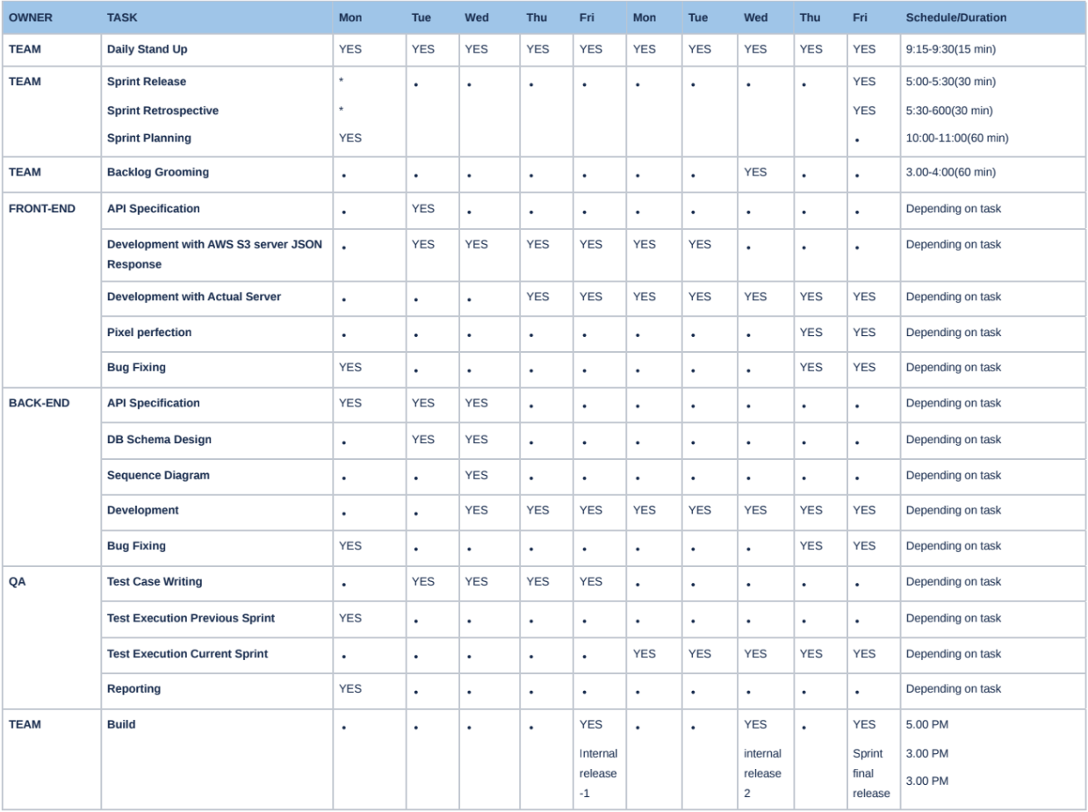
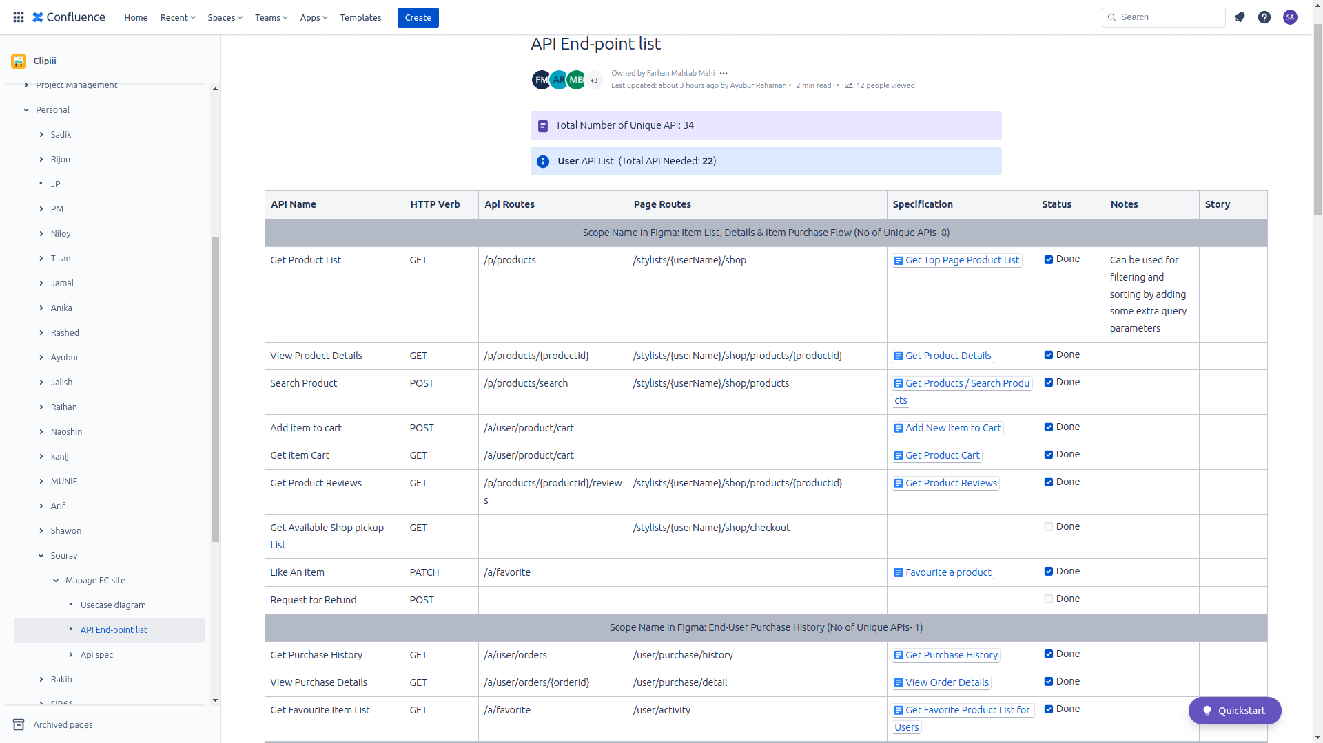
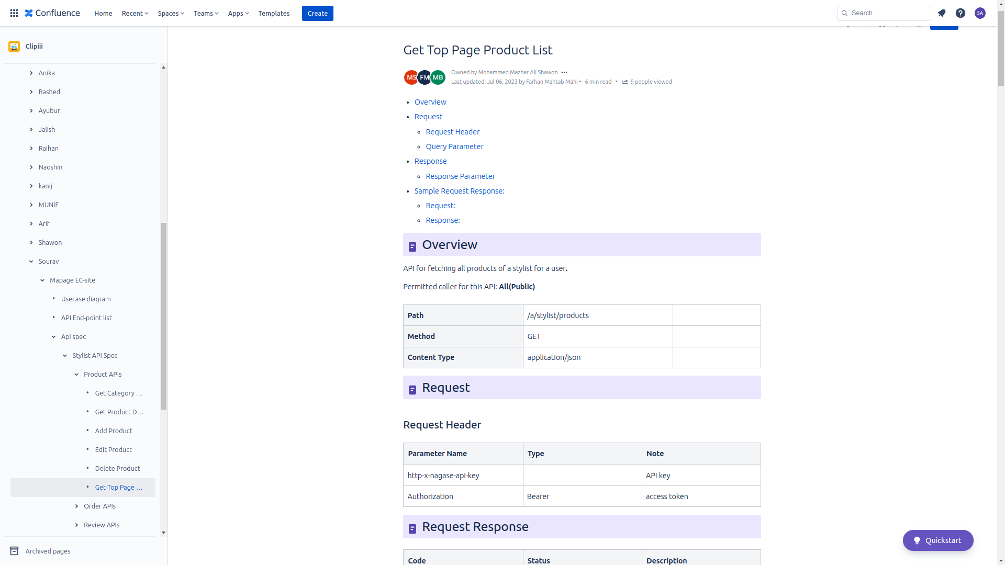
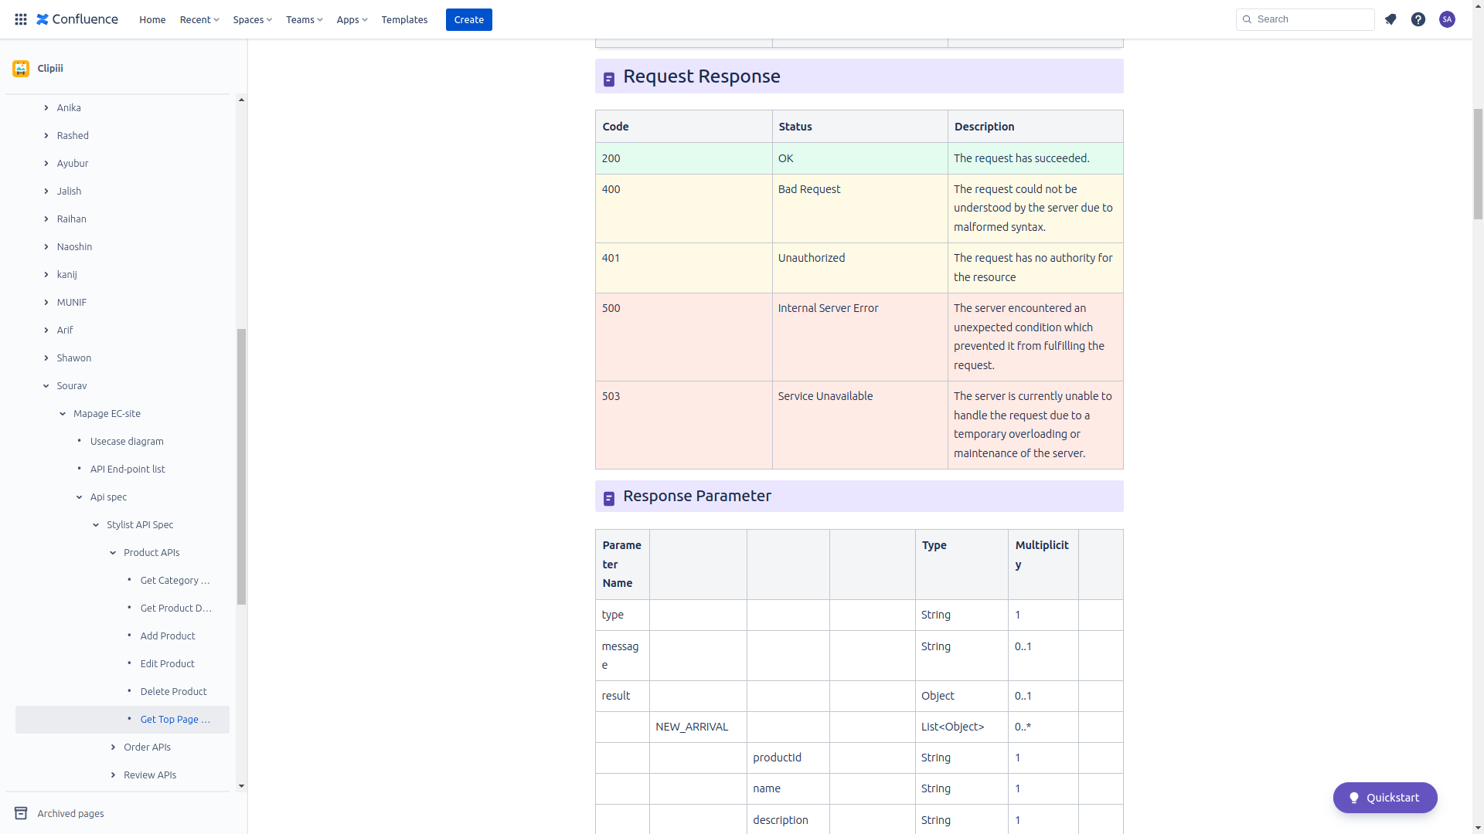
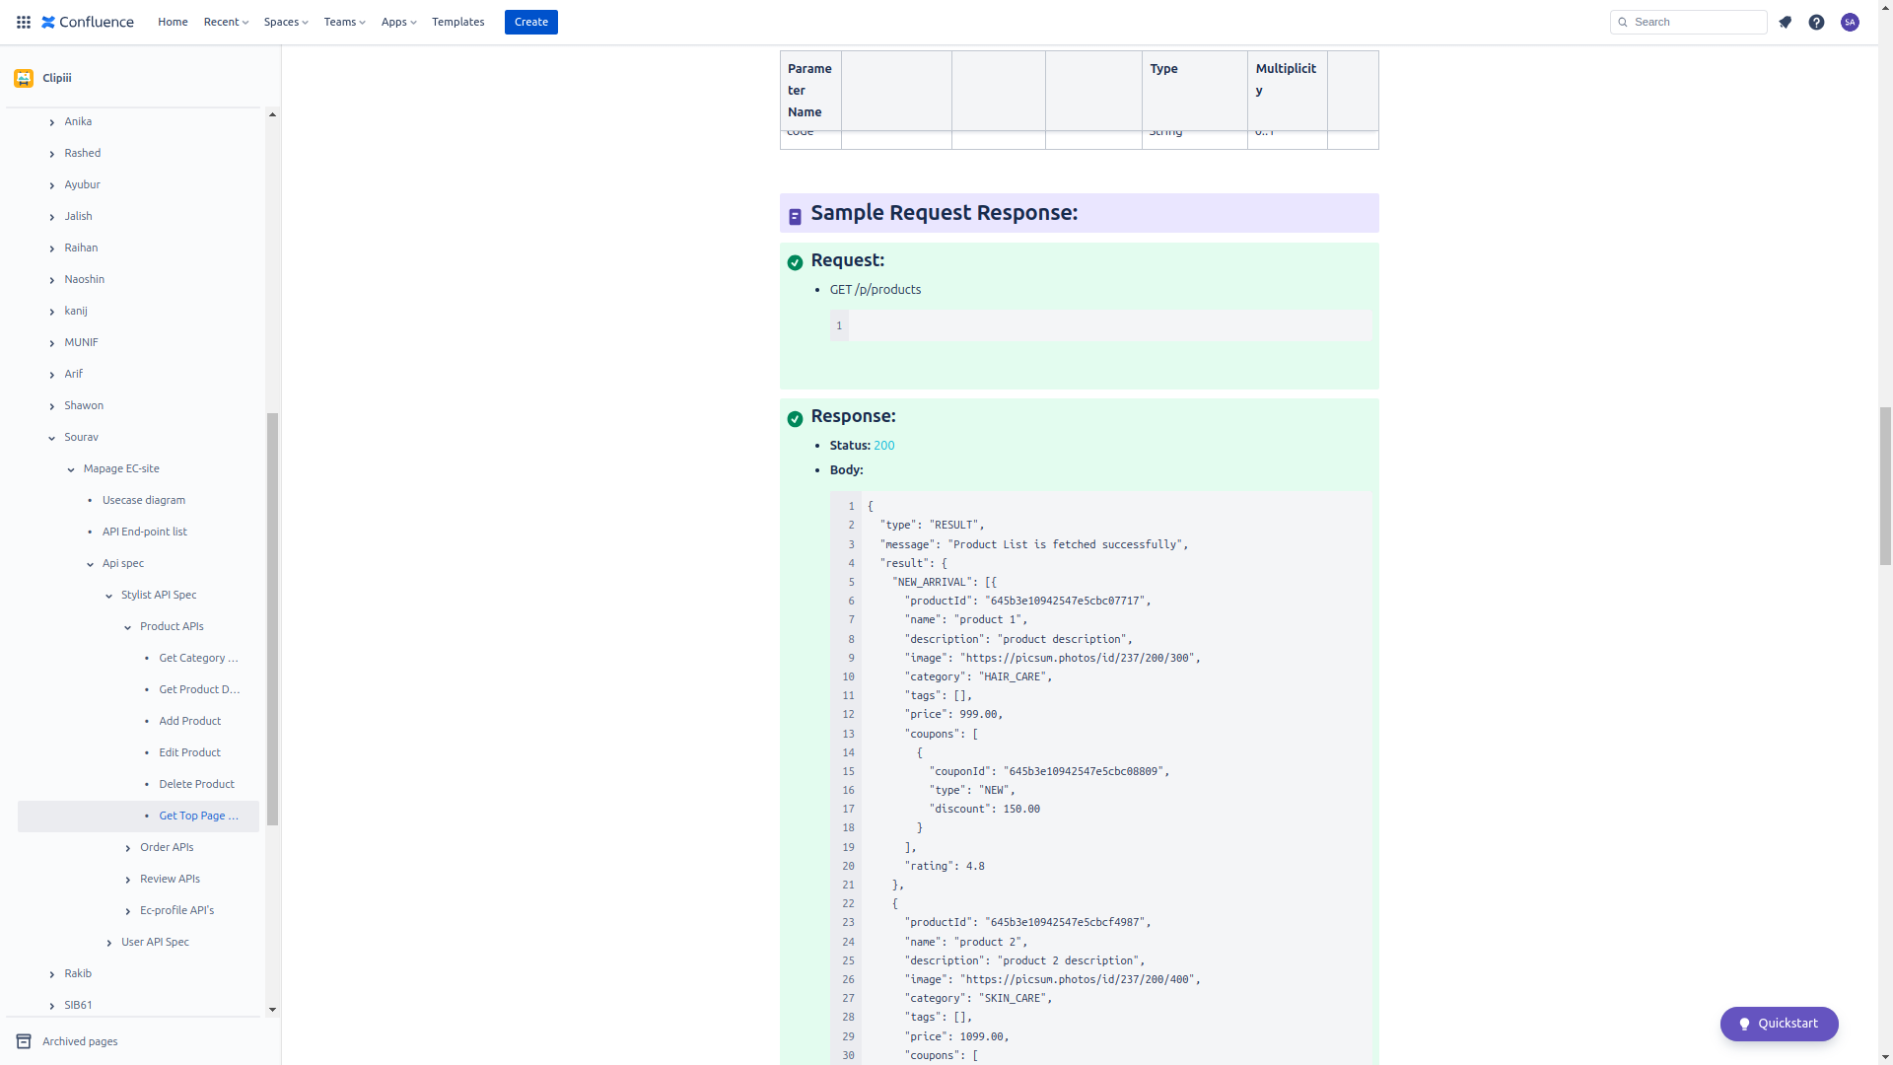
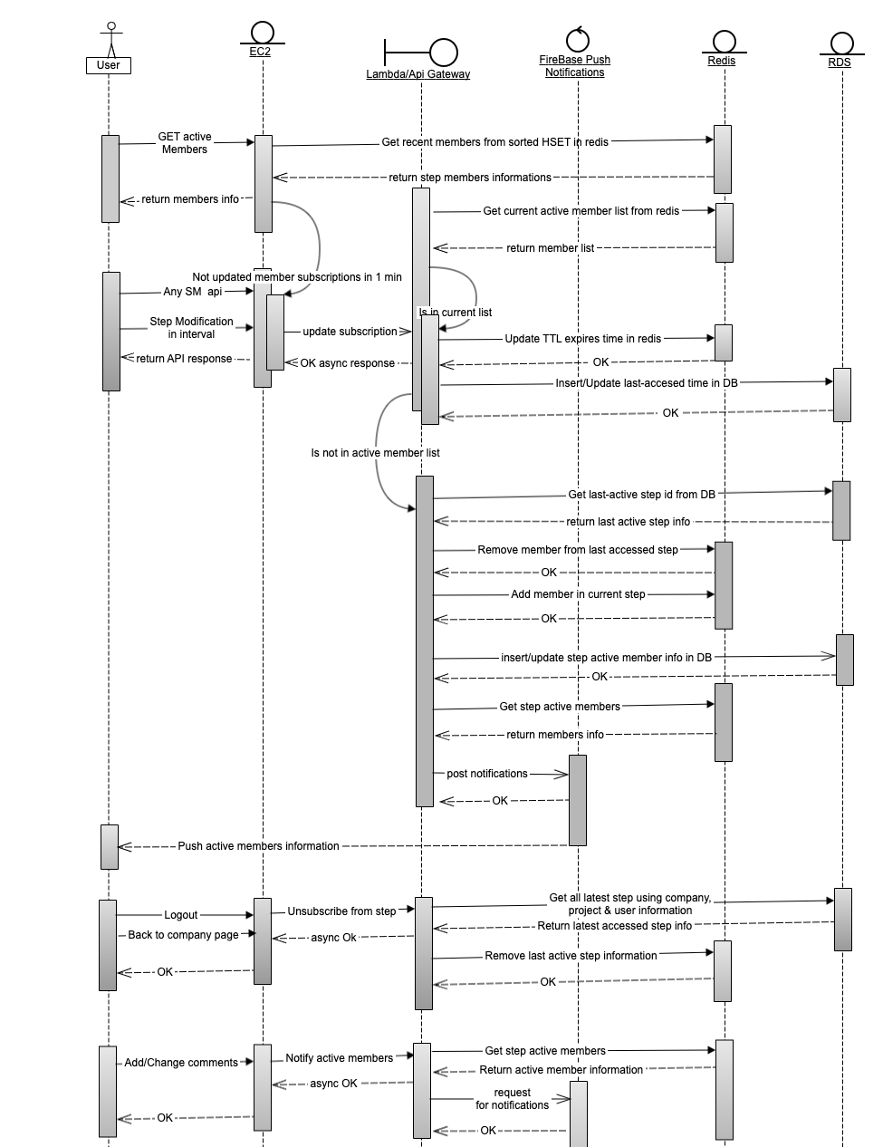
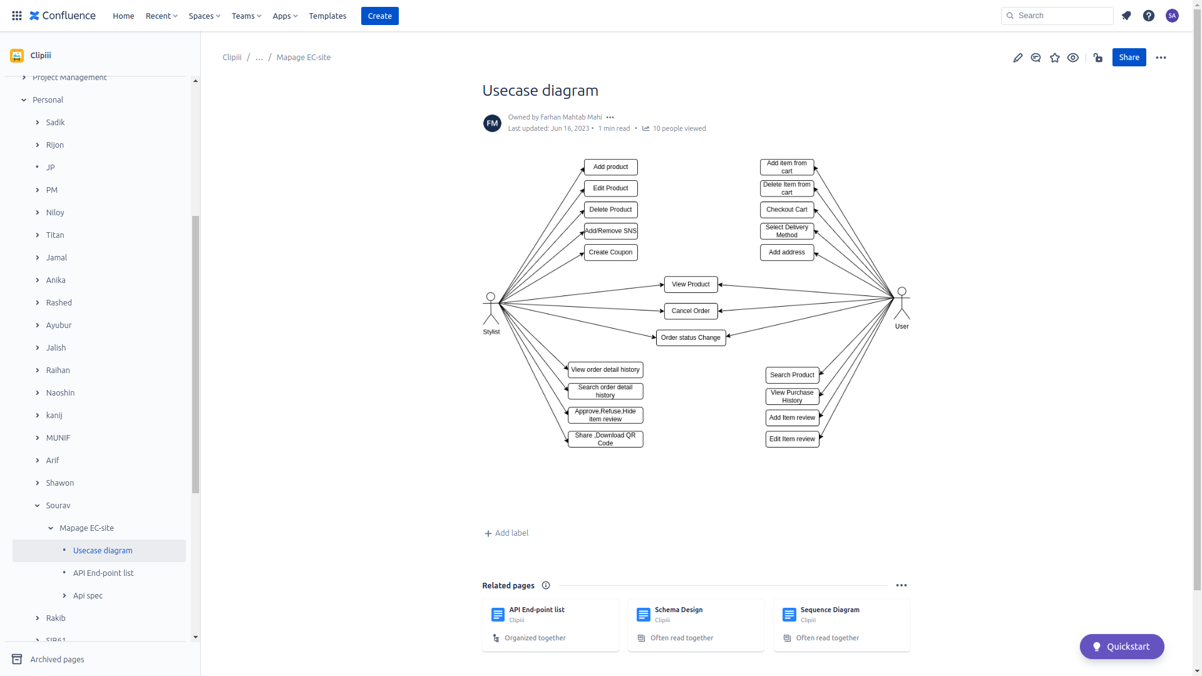
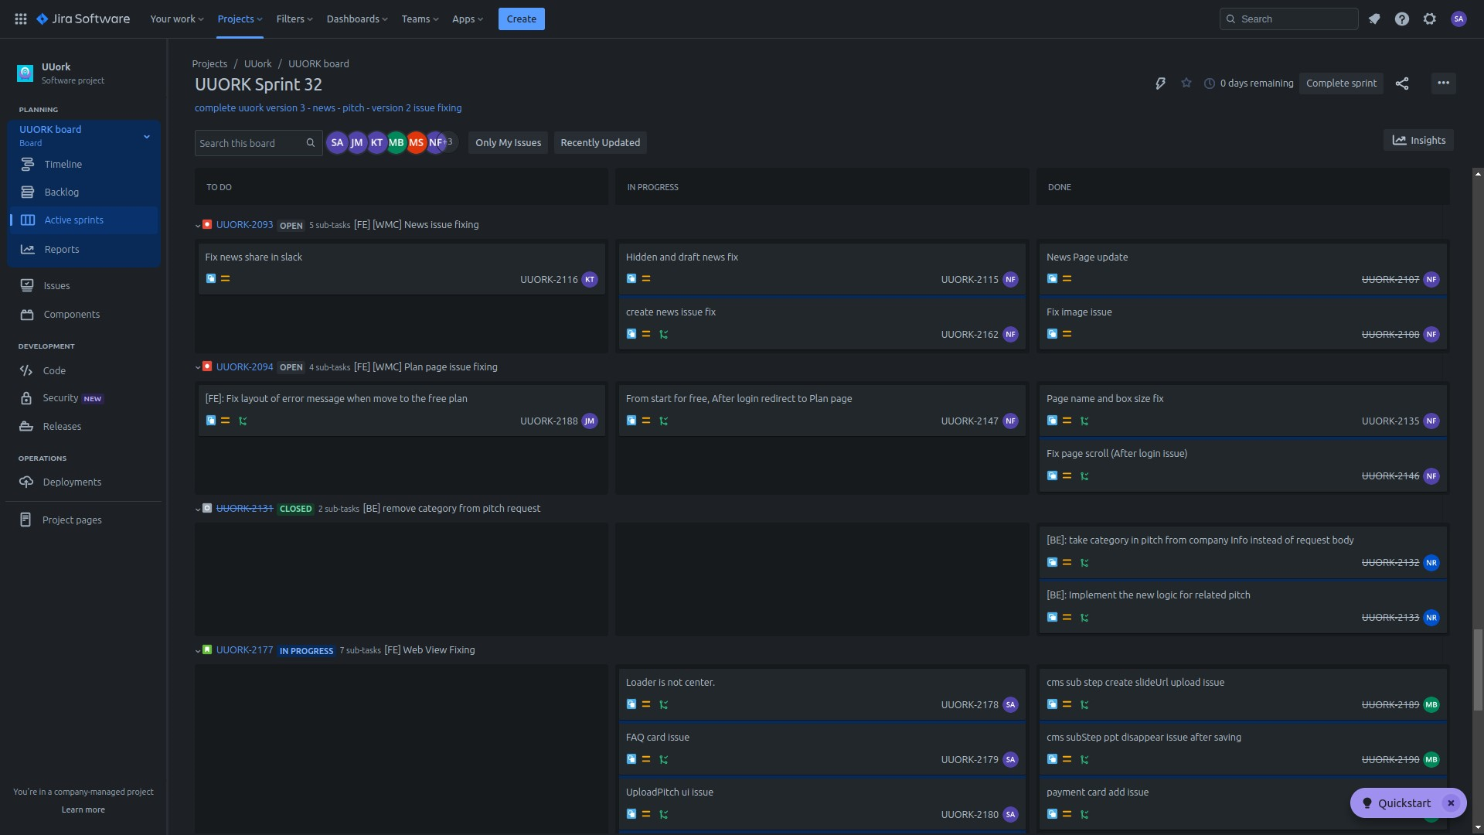
Phase 2: Learning Software Development Methodologies, Software Architecture, and High-level Design
Waterfall vs. Agile
Scrum
Sprint and Story Point Estimation
SQL vs NoSQL
Database Design
API specification writing
Usecase Diagram Activity Diagram Sequence Diagram
Git branching strategy How to work in a team

Slide 16
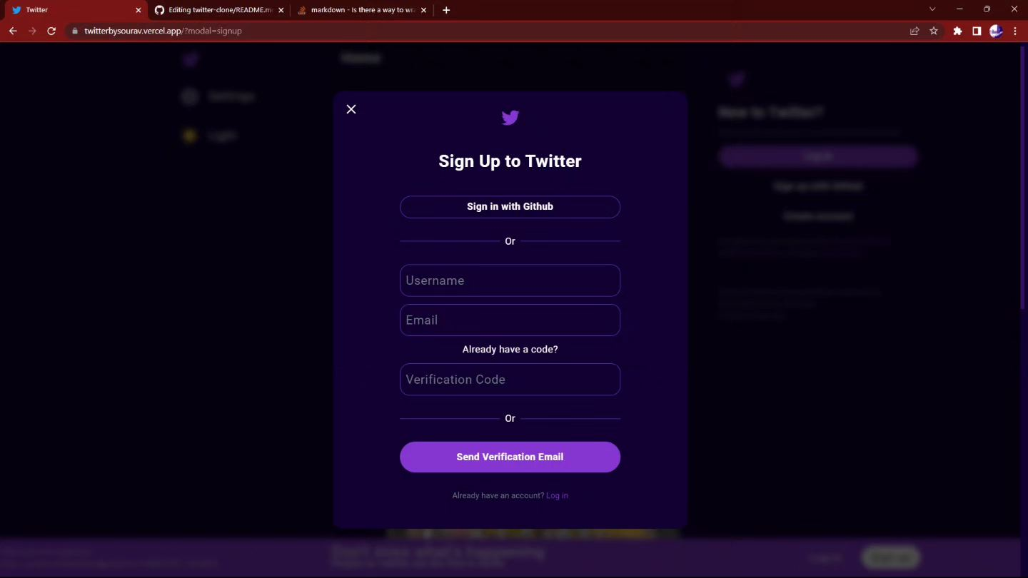
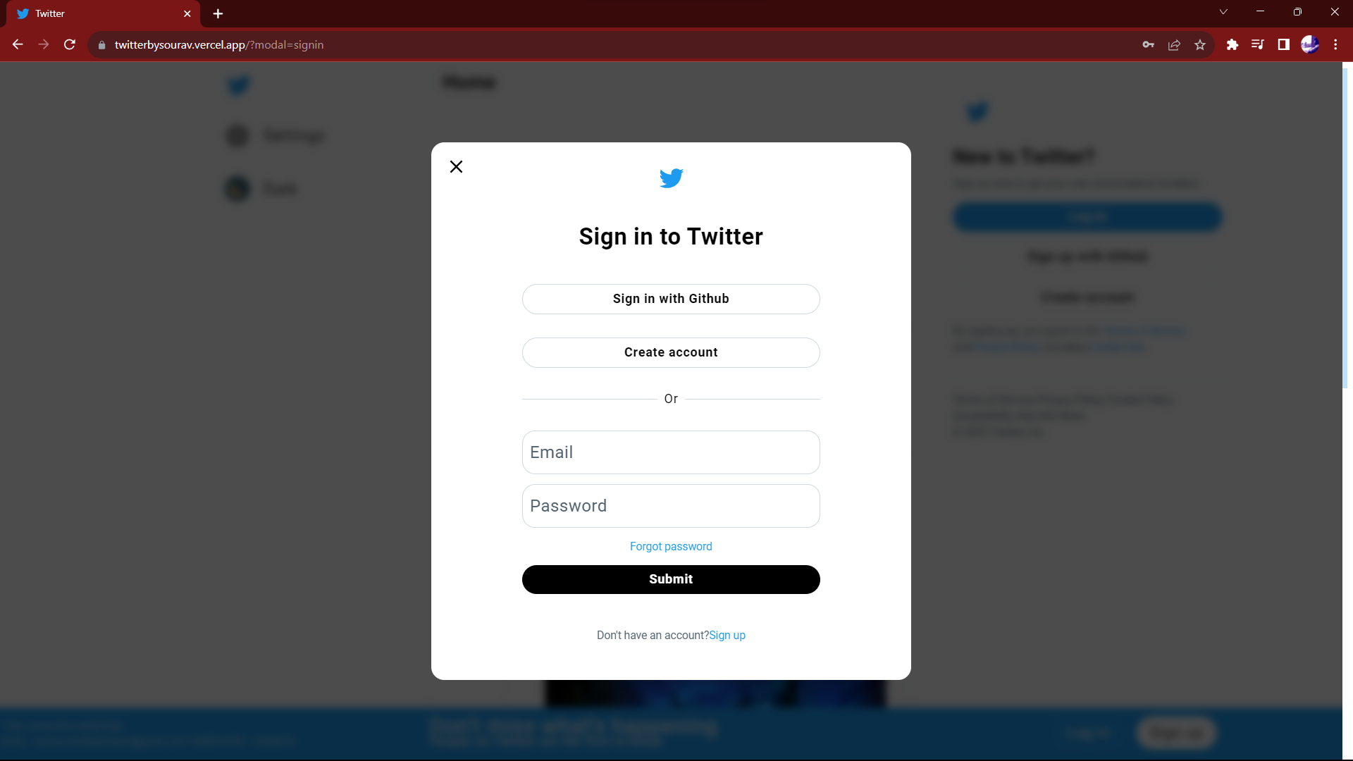
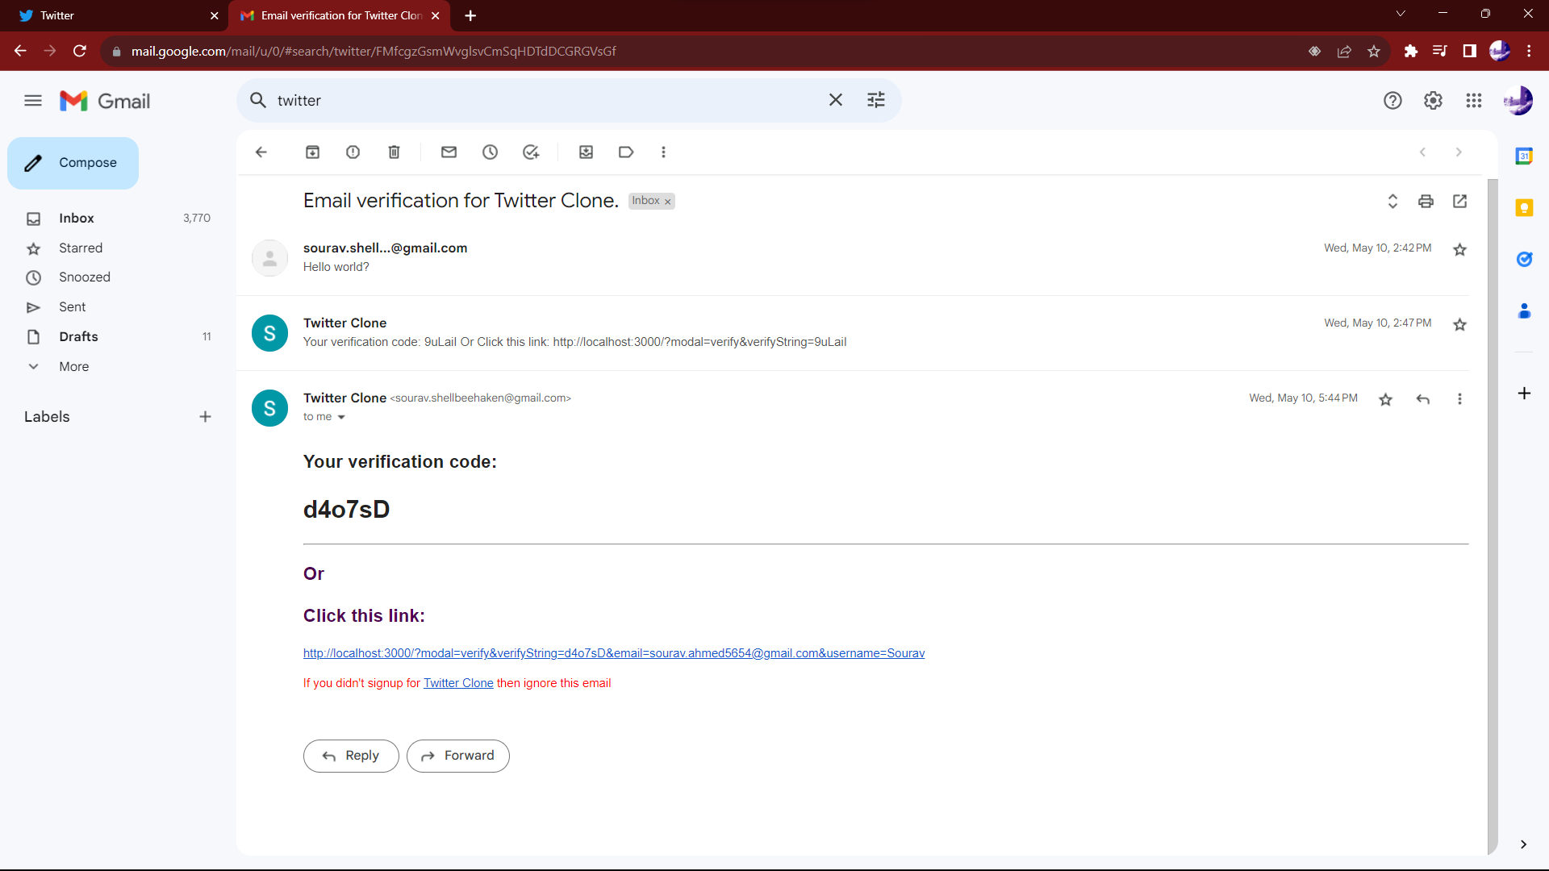
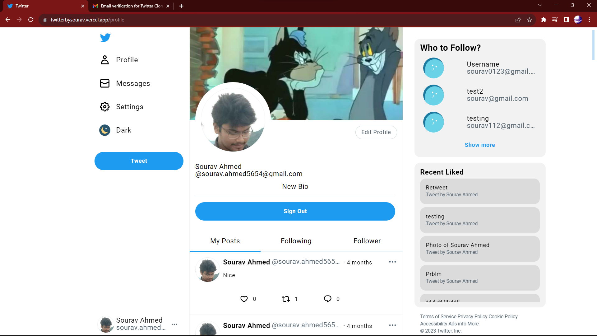
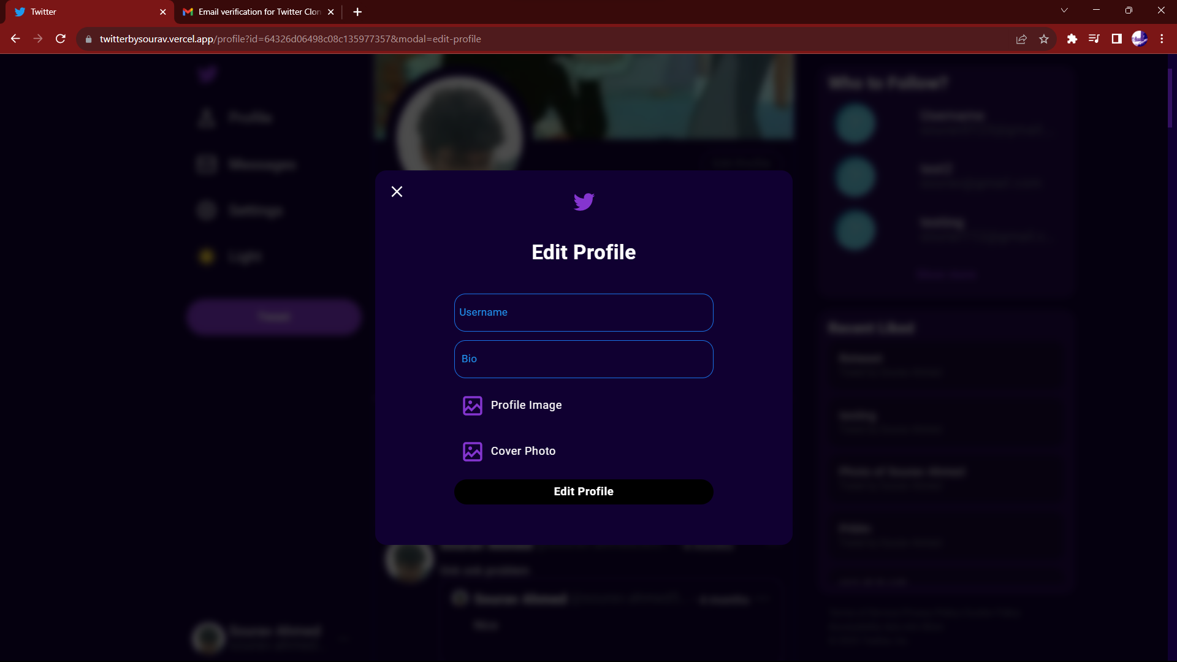
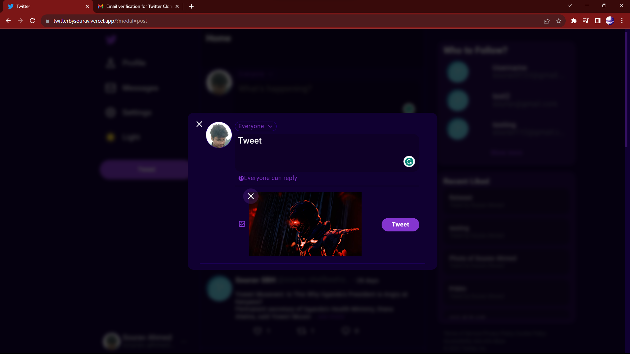
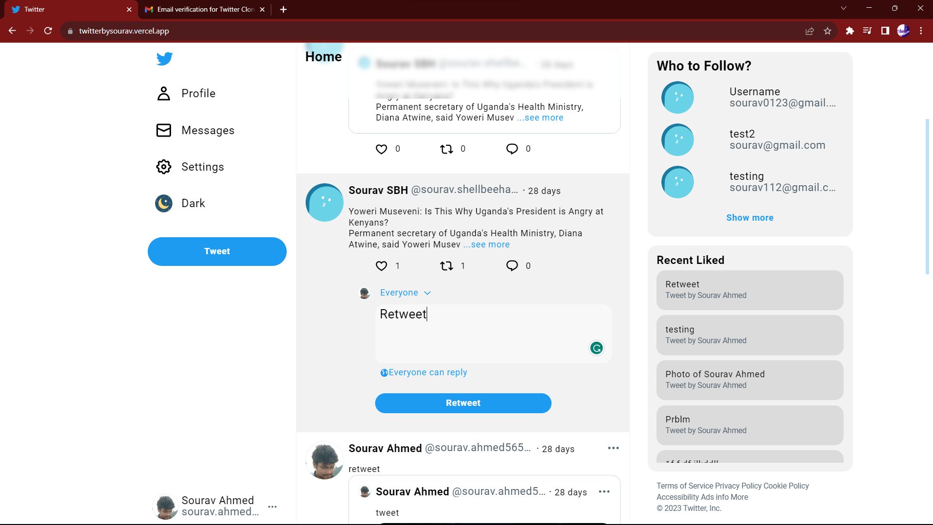
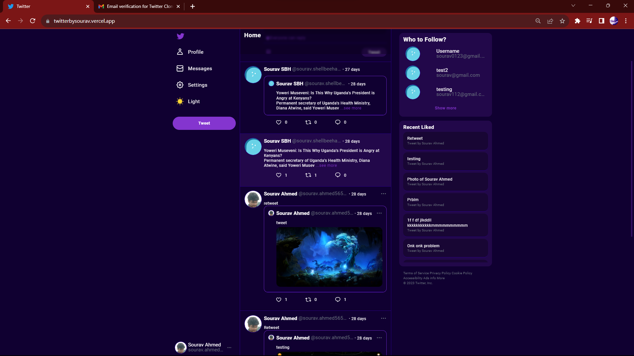
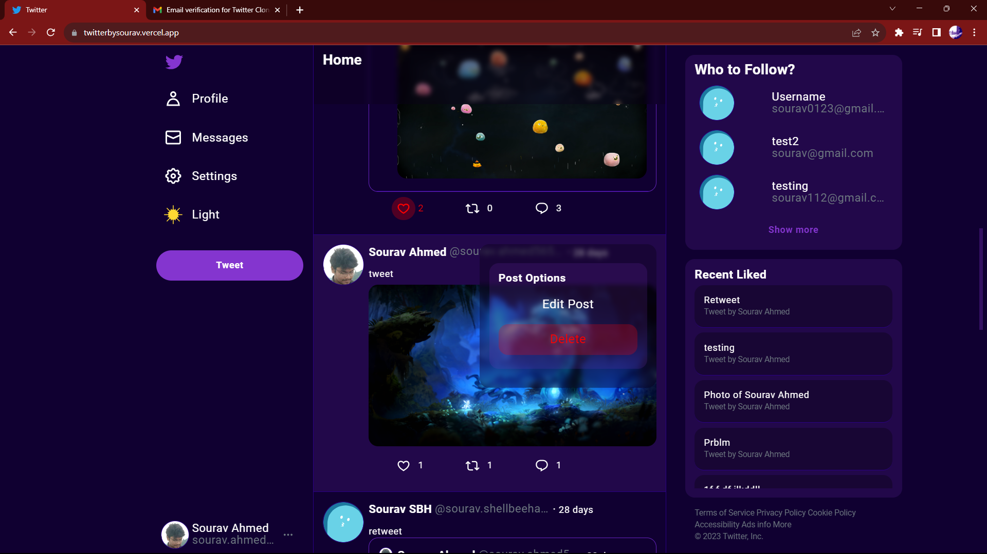
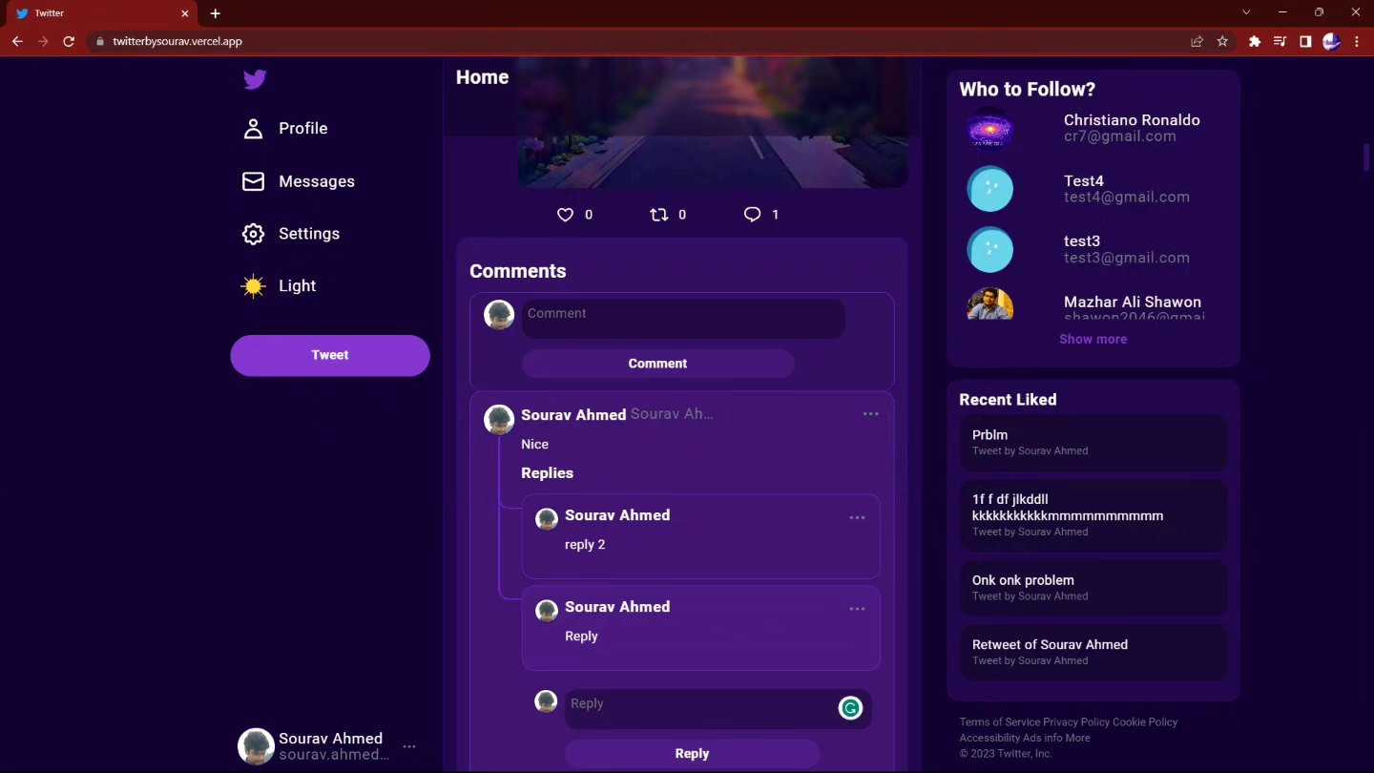
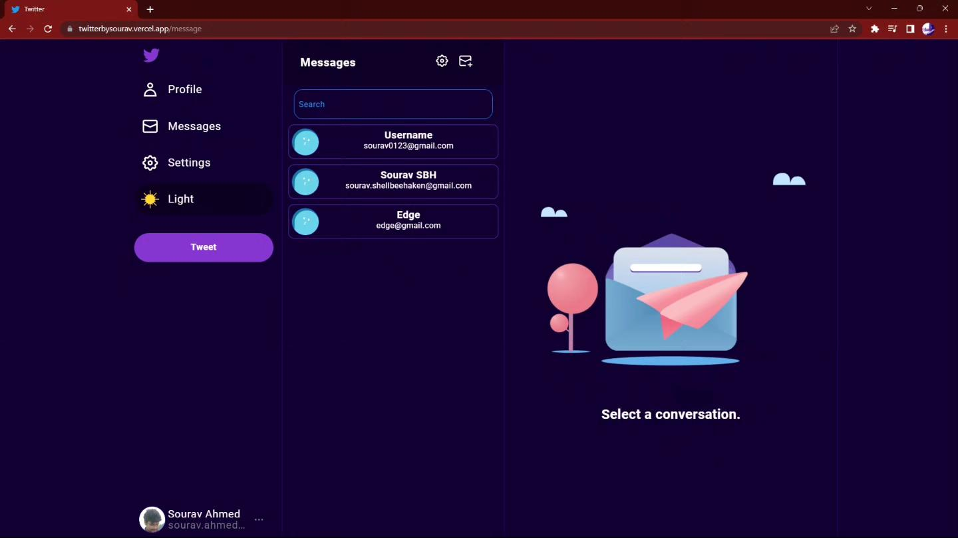
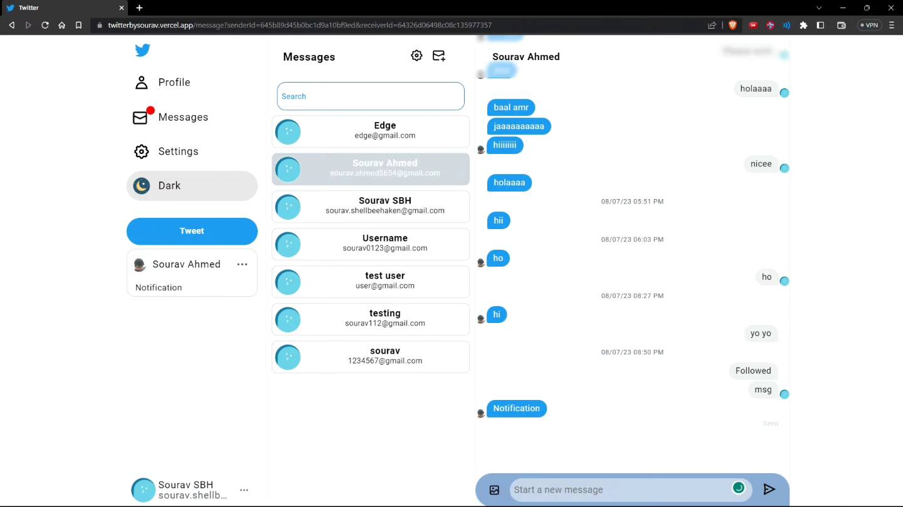
Phase 3: Full Stack Project
We individually had to create Twitter clone with following feature.
Sign Up, Login Using Email, and GitHub Authentication
Email Verification
Profile Create Edit
Image Upload
Tweet Retweet
Tweet Fetching Sorting By Followee, Likes and Comments
Like Comment Reply
Follow Unfollow
Messaging
Notification Using WebSocket and Firebase
API documentation

Slide 17
Phase 4 :Working on the Company’s Live Projects
Last one and a half months I got the opportunity to work 3 of Live Projects and gather much-needed work experiences
UUORK web
UUORK Desktop
****** ***** **********

Slide 18
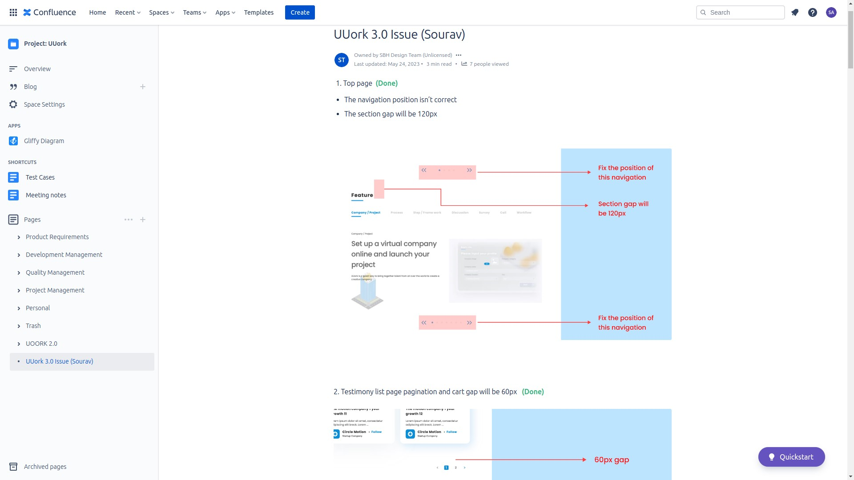
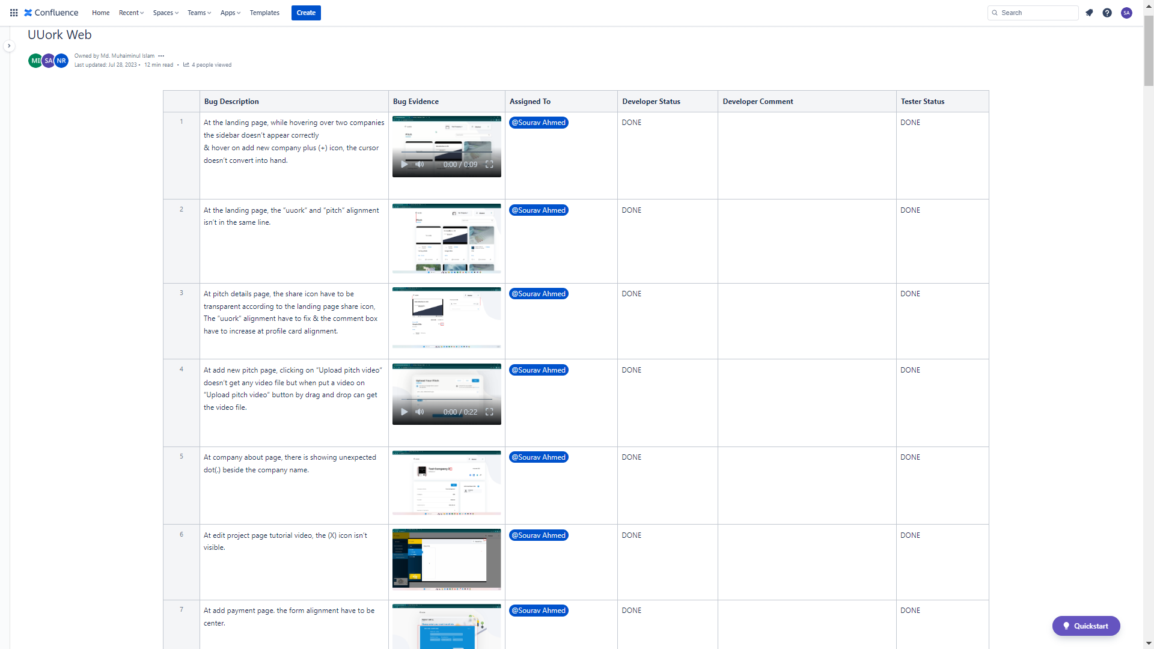
UUORK WEB
Technology:
NextJs, MongoDB, Redux Saga, ExpressJs ,Spring Boot, MySQL, Redis, AWS Lamda
Features I worked on:
Fixed Responsive issues
Implementing Automatic Regeneration of Access Token And Next Auth SignIn
Fixed 70+ Web Issues

Slide 19
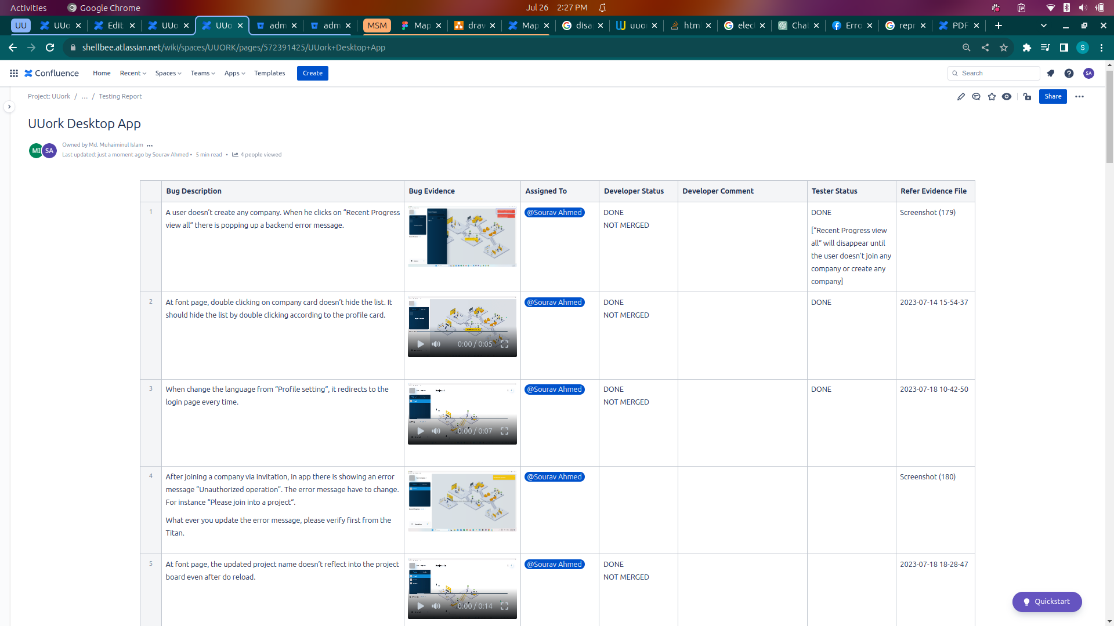
UUORK Desktop
Technology:
ElectronJS, Firebase Cloud Messaging
Feature I worked on:
Fixed 40+ bugs of UUORK Desktop
Implemented automatic LogIn with new access token

Slide 20
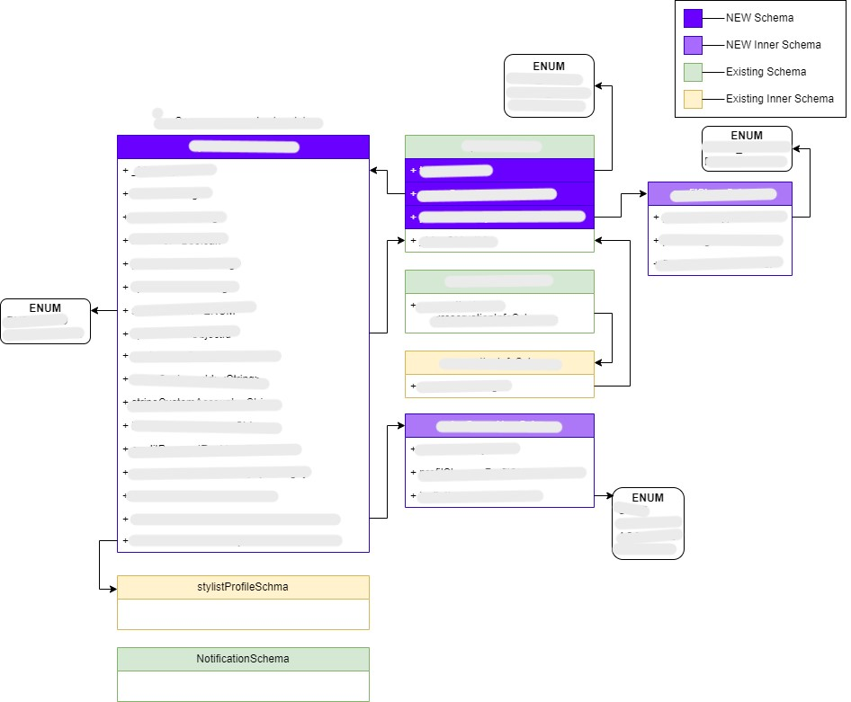
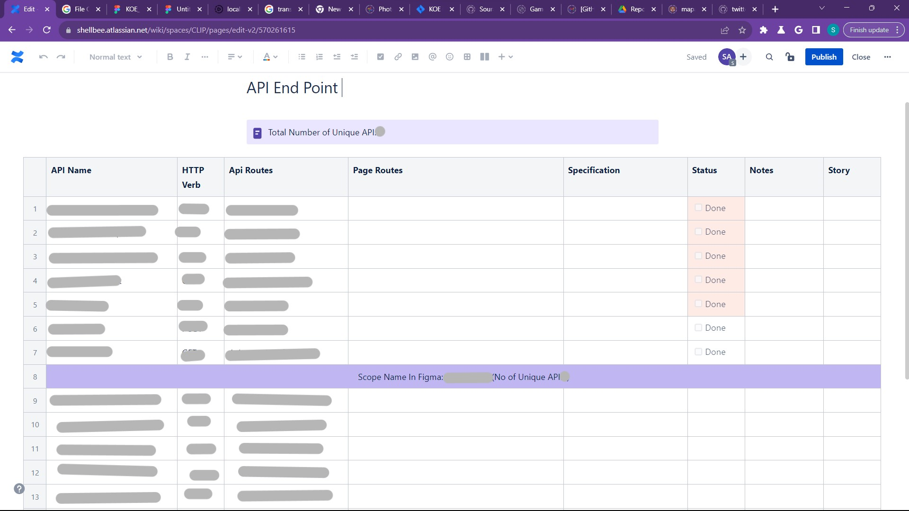
****** ***** **********
It is a adjacent project for Mapage. This project was kicked off during the last 2 weeks of my internship.
My Work:
Design a Database that would work smoothly with the existing Mapage payment and reservation system.
Find the needed API endpoints and write the API specifications

Slide 21
Skills Achieved from SBH
Communication Skills
Teamwork Skills
Professionalism
Punctuality
Knowledge Sharing
Quality of Work
Adventurous
Critical Thinking
Empathy
Dedication
Attitude

